Slide 1
Wireshark, S/MIME and Snort
Lab guide

Slide 2
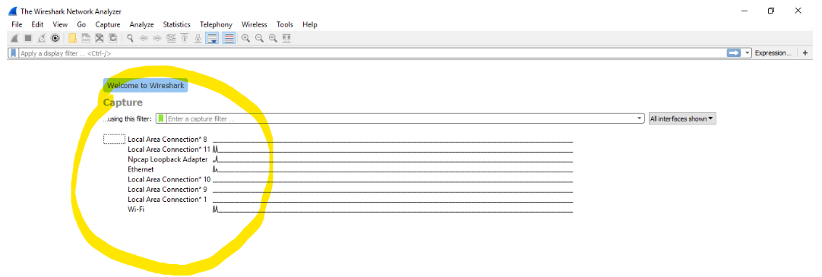
Wireshark
Install wireshark and open it.
After opening choose the interface or connection from which packet will be captured.

Slide 3
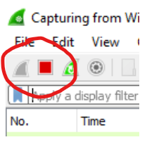
Now wireshark will start capturing packet automatically.
Now we will open a http login page and type any user credentials which will be captured by wireshark.
We will stop the wireshark.

Slide 4
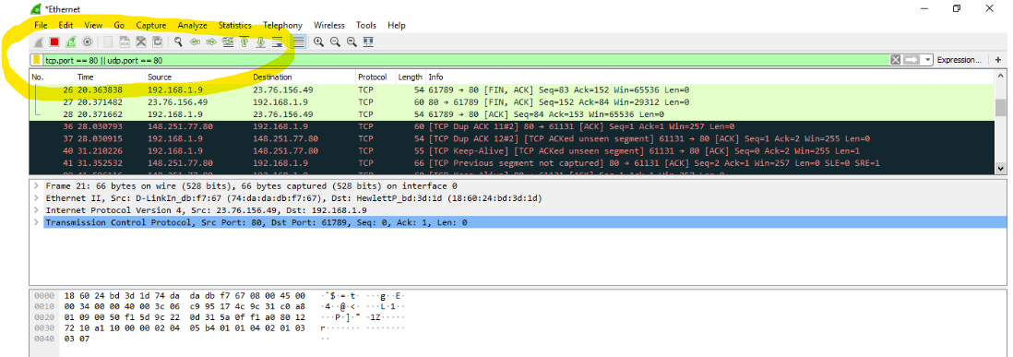
Now using display filters we choose to check only http traffic. We can do it by typing directly the port no used by http or just http.

Slide 5
After filtering the packets inspect the those carefully and retrieve the credentials.

Slide 6
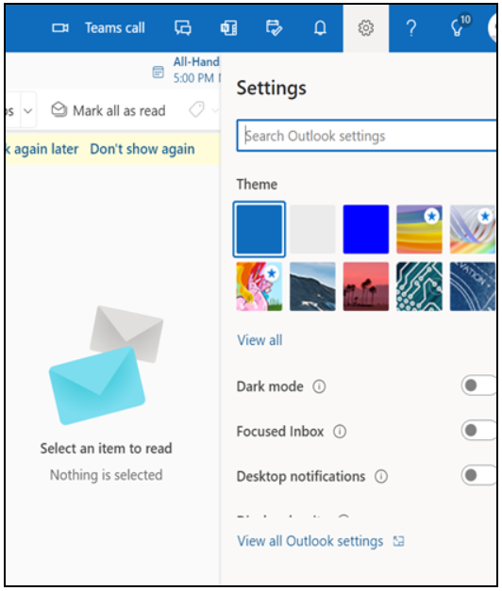
S/MIME
Download PKCS#12 file containing certificate
from any service provider like ssl.com,
globalsign.com etc and install it.
Open Microsoft office 365.
Then open Microsoft outlook.
Go to settings, then, click on view all outlook
settings

Slide 7
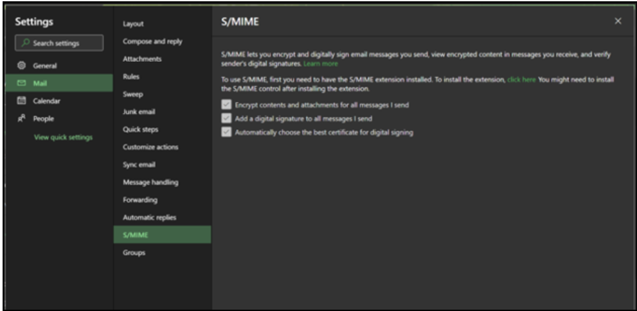
Go to Mail – S/MIME. Make sure to mark all boxes in order to use the Certificate.

Slide 8
Send an Email. By default all outgoing emails have a Certificate.

